Slide 1
Data Service Server Roadmap
SPRINT IV
Deployment
Env Testing: NAS Deployment
Env Change: Change IP (Research)
HA (Three Nodes)
Software Component, v-1.3.x
LDAP
User Manual, Training Material
SPRINT III
Deployment
Scaling up, 1 -> 2
Software Component, v-1.2.x
ChartDiscovery/Marketplace
ChartManagement/Deployment
User Manual, Training Material
SPRINT II
Deployment
Two Nodes, HDD 1T/5T
Dynamic Configuration
Software Component, v-1.1.x
Logging Management
Private Docker Registry
Ceph Exporter
User Manual, Training Material
SPRINT I
Single Node (Master), HDD 1T/5T
Software Component, v-1.0.x
DeviceOn/EdgeSense Built-in
Private Chart Repo
User Manual, Training Material
2019/Jul
2019/Aug
2019/Oct
2019/Dec
2020/Q1

Slide 2
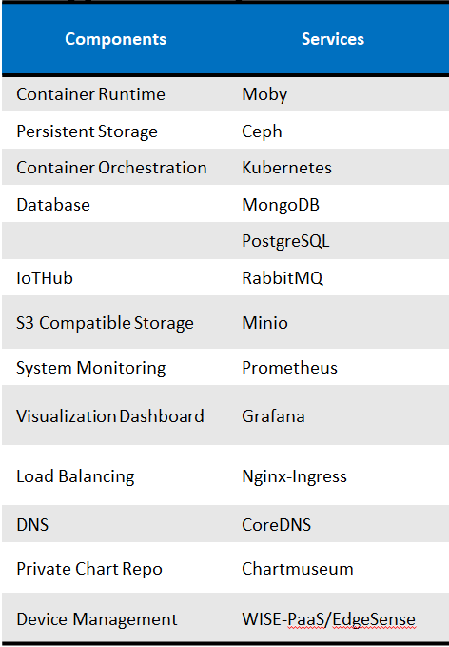
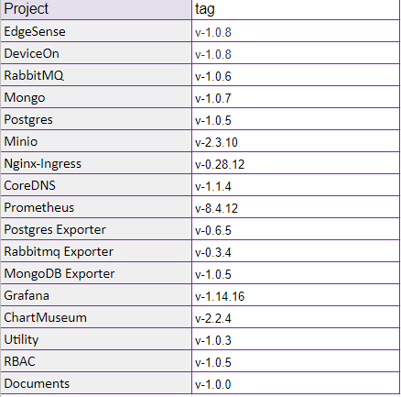
Software Component, v-1.0.0

